Slide 1
CEF 440: INTERNET PROGRAMMING(J2EE) AND MOBILE PROGRAMMING GROUP 16
PRESENTED BY:
AJAMAH GODLOVE NKEMEJAH FE21A129
AMABO JOSHUA NGWA FE21A135
MBACHAM LOANA NING FE21A228
NGOUNG TASSA ALAIN SHIRESS FE21A262
NYUYSERVER BORIS DINNYUY FE21A295
TASK 6

Slide 2
TABLE OF CONTENTS
01
INTRODUCTION
02
REQUIREMENT ANALYSIS
03
CONCEPTUAL MODEL DESIGN
04
LOGICAL DESIGN
05
IMPLEMENTATION
06
CONCLUSION

Slide 3
This report presents a comprehensive design for an attendance management system that uses fingerprint authentication to track student attendance. The design process includes various stages: requirement analysis, conceptual design, logical design, physical design considerations, and normalization. Each stage is discussed in detail to ensure clarity and completeness.
01: INTRODUCTION

Slide 4
Database: A database is a structured collection of data that is stored and accessed electronically.
Entity: An entity is an object or concept about which data is stored in a database.
Attribute: An attribute is a property or characteristic of an entity.
Primary Key (PK): A primary key is a unique identifier for a record in a database table.
Foreign Key (FK): A foreign key is an attribute that creates a relationship between two tables.
ER Diagram (Entity-Relationship Diagram): An ER diagram is a visual representation of the entities in a database and their relationships.
1.1: DEFINITION OF KEY TERMS

Slide 5
The main requirements for the attendance management system include:
User Management: Managing different types of users (students, lecturers, administrators).
Attendance Tracking: Tracking student attendance in various courses.
Fingerprint Authentication: Using fingerprint data to authenticate users.
Course Management: Managing courses and their respective departments.
Administrative Functions: Enabling administrators to manage users and generate reports.
02: REQUIREMENT ANALYSIS

Slide 6
A. Some Database Requirements are;
Security
Performance
Scalability
B. Key entities identified from these requirements are:
User
FingerprintData
Admin
Student
Lecturer
Department
Course
AttendanceRecord
2.1:DATABASE REQUIREMENTS

Slide 7
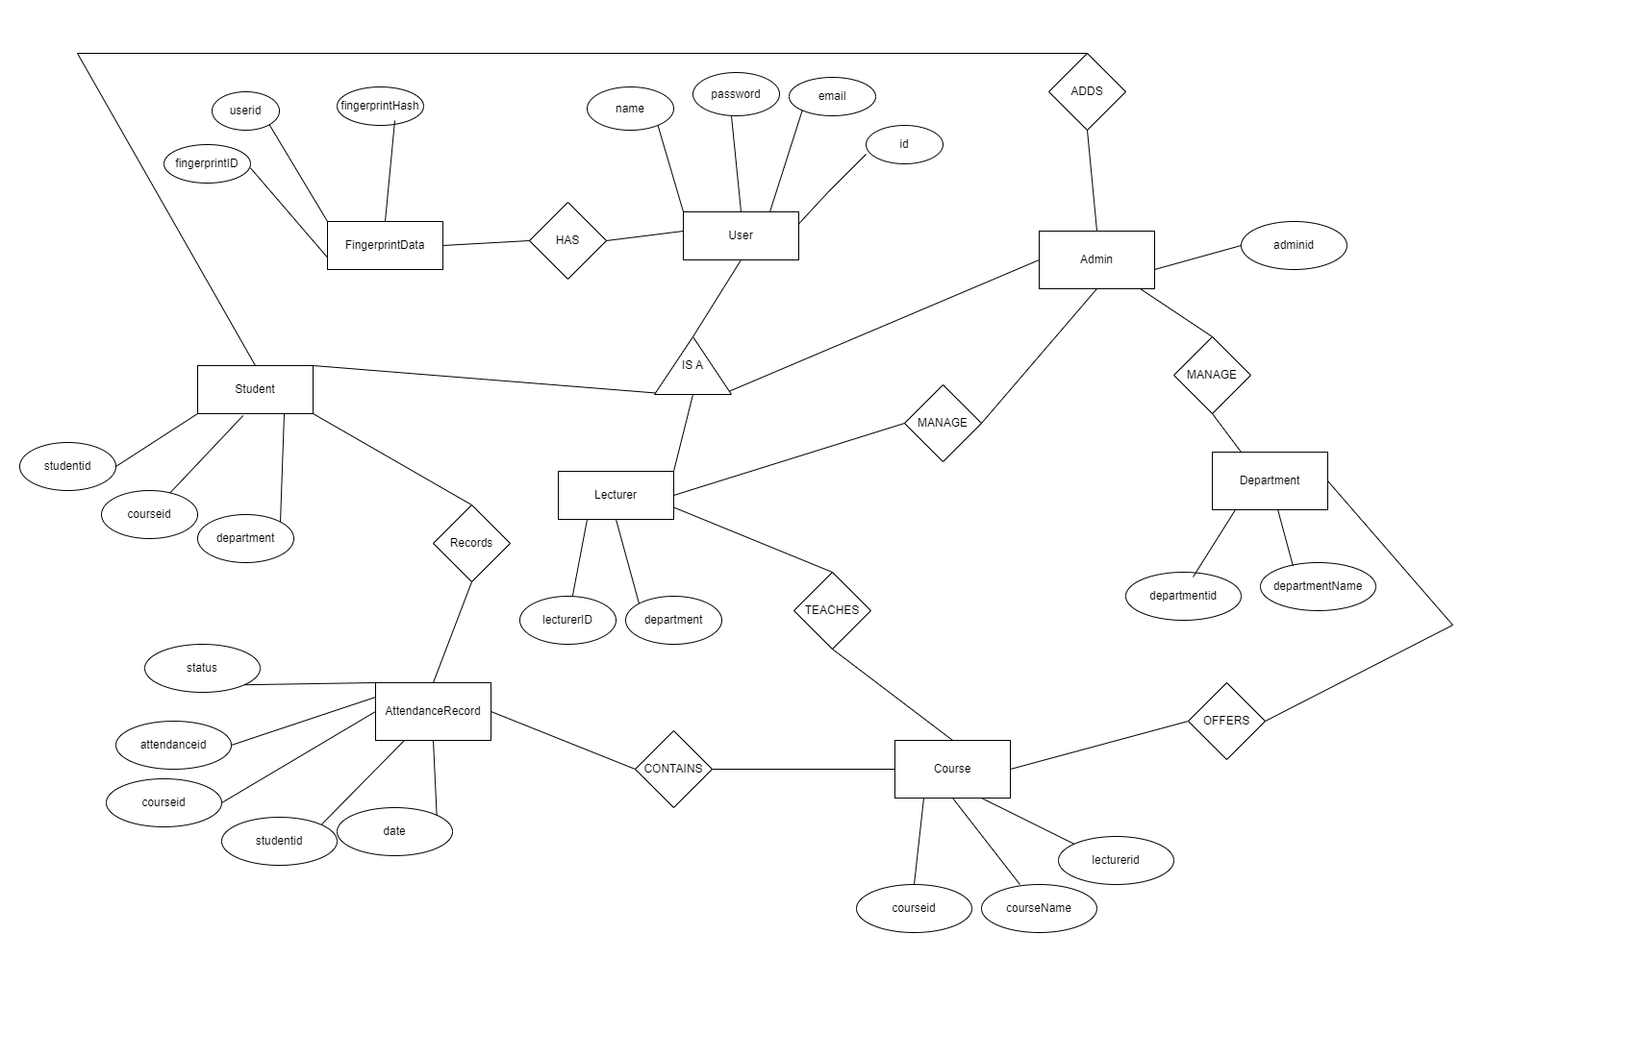
The conceptual design phase involves creating a high level data model, often represented as an ER diagram. This ER Diagram is shown below.
03: CONCEPTUAL DESIGN

Slide 8
-The logical design phase involves translating the conceptual model into a relational schema.
-We have the following features in our relational schema;
Tables: Each entity becomes a table (User, FingerprintData, Department, etc.)
Primary Keys (PK): Each table has a unique identifier (e.g., studentId for Student).
Foreign Keys (FK): Relationships are established using foreign keys. For example, AttendanceRecord references studentId (Student) and courseId (Course).
Below is a diagram representing the relational schema:
04: LOGICAL DESIGN

Slide 9
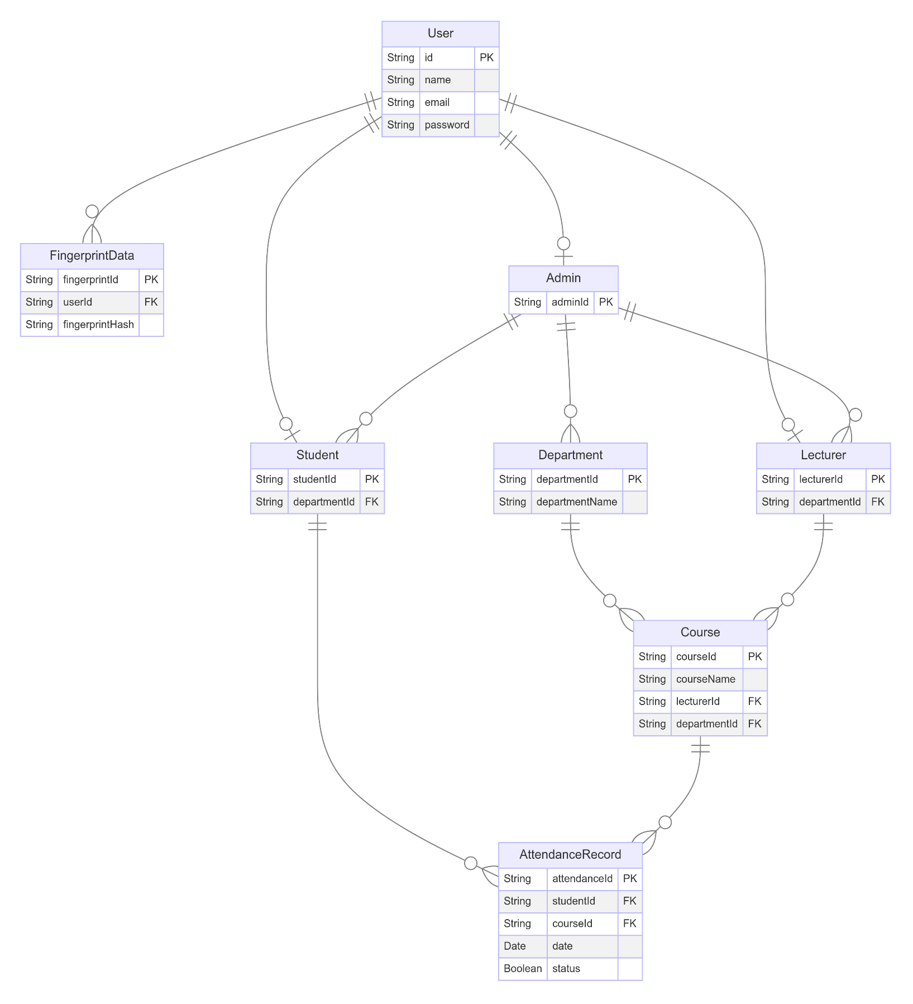

Slide 10
The logical schema is further defined for a specific DBMS;
Data Types:VARCHAR for names, DATE for attendance date
Constraints: CHECK constraints to ensure boolean values in AttendanceRecord.status
Indexes: studentId in AttendanceRecord
Data Security: The following key points are noted during security analysis;
Fingerprint Storage: Fingerprint data should be stored using a one-way hashing function that creates a unique identifier (template) from the fingerprint data.
Encryption: Sensitive data fields, such as password and contact information, should be encrypted at rest and in transit.
Access Control: Grant access to attendance data only to authorized personnel (lecturers, administrators).
4.1: PHYSICAL DESIGN

Slide 11
-We used Firebase for our database implementation.
Some of the main functionality it provides to developers includes;
A real-time database
File storage
User authentication
Crash reporting tools
-The Firebase Realtime Database is a cloud-hosted NoSQL database that enables easy real-time syncing of data between clients.
-Below are the different collections created;
05: IMPLEMENTATION

Slide 12
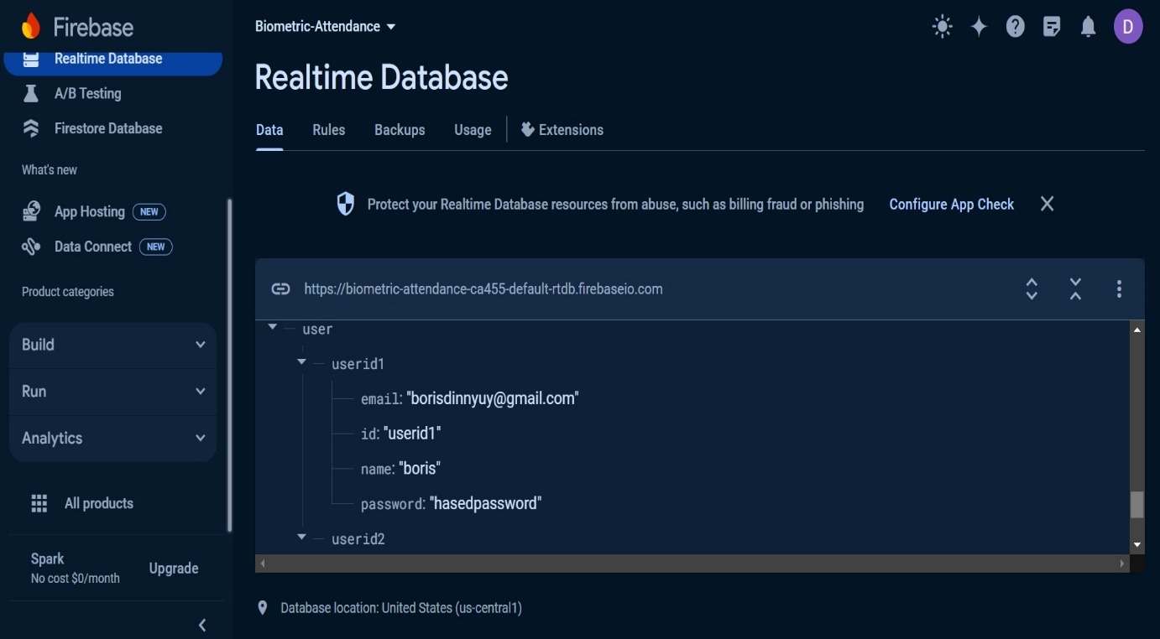
User collection

Slide 13
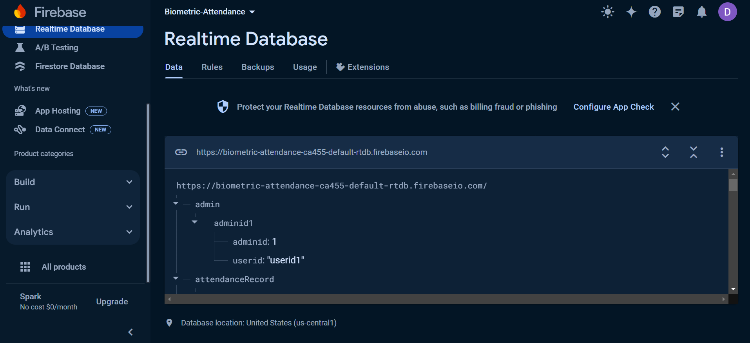
2. Admin collection

Slide 14
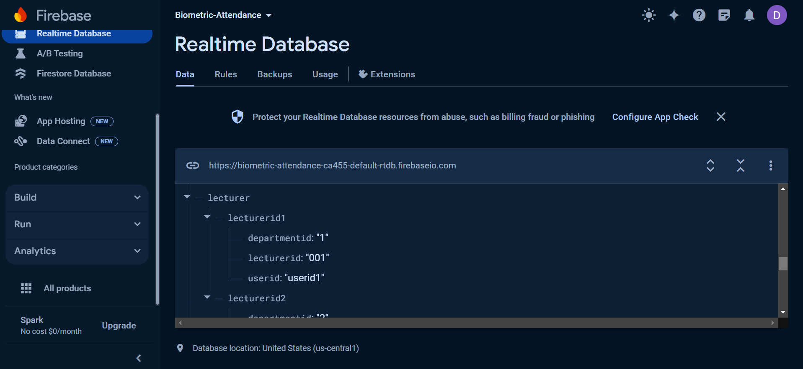
3. Lecturer collection

Slide 15

4. Student collection

Slide 16
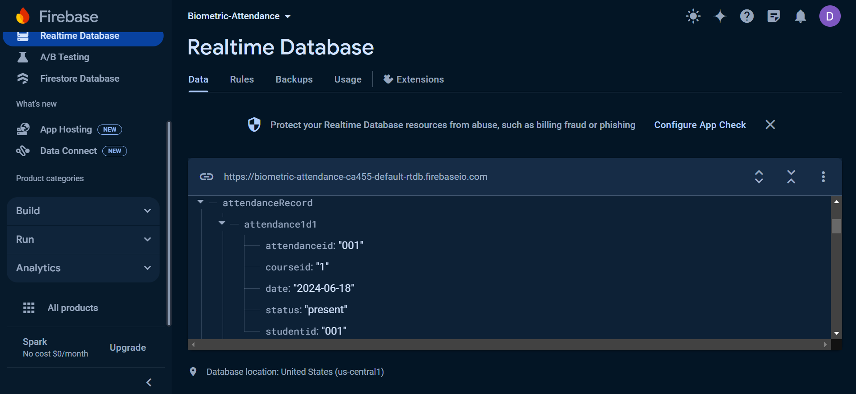
5. AttendanceRecord collection

Slide 17
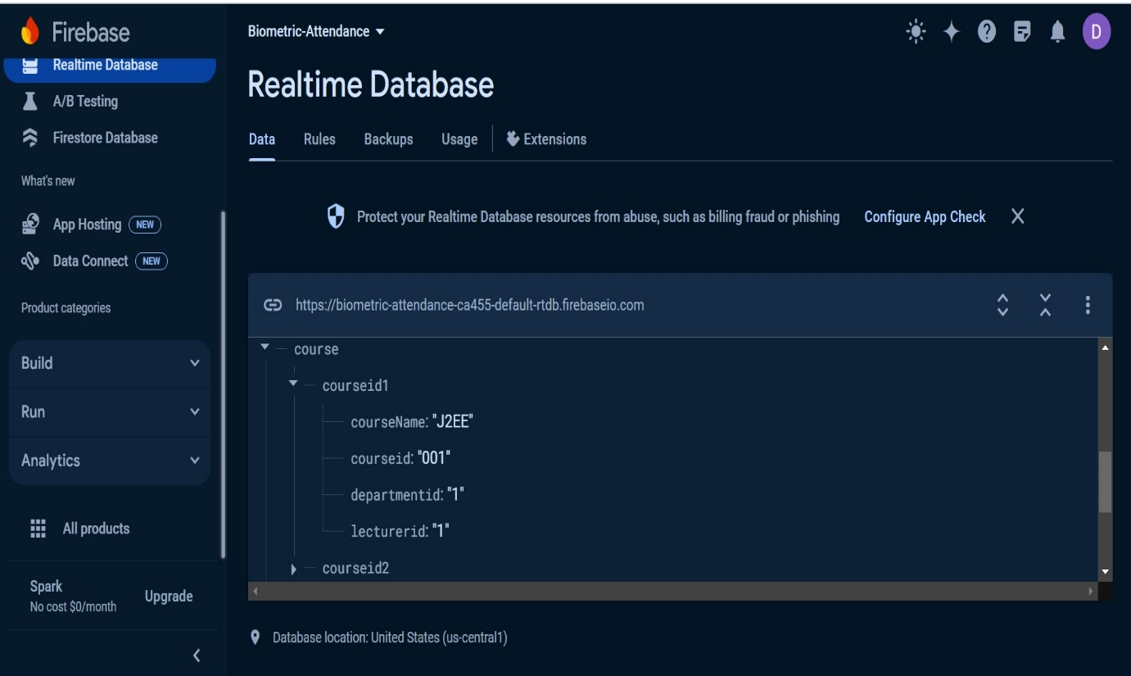
6. Course collection

Slide 18
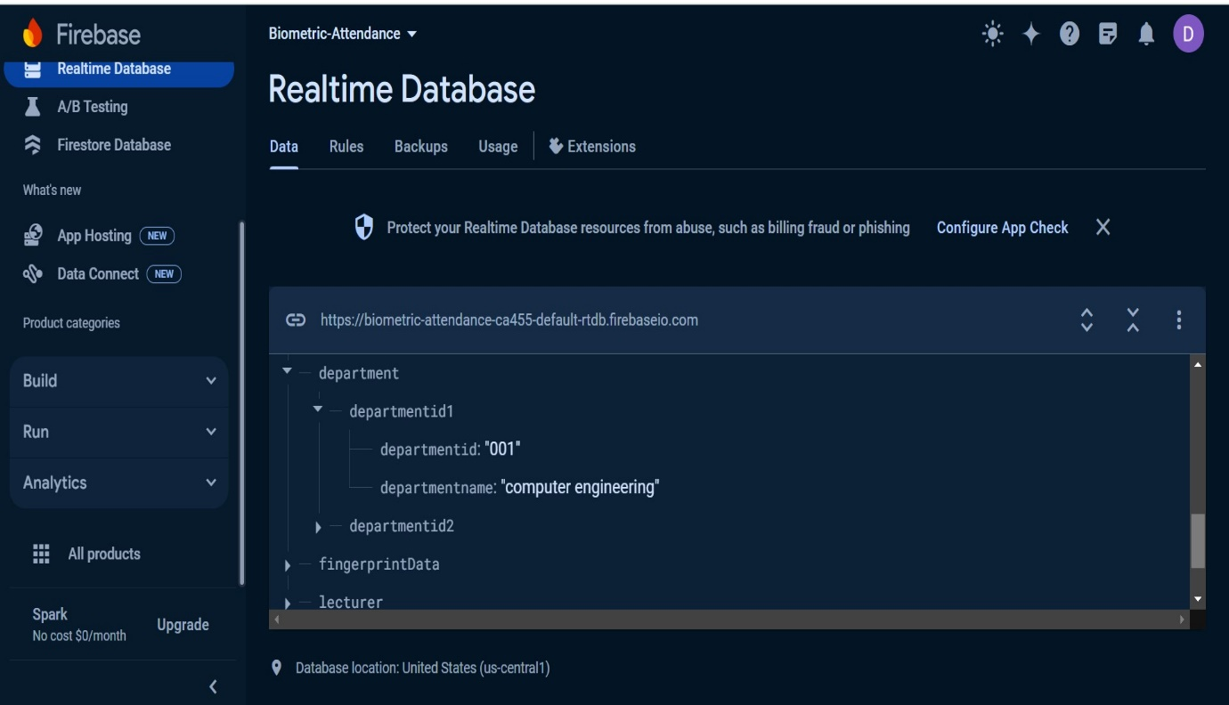
7. Department Collection

Slide 19
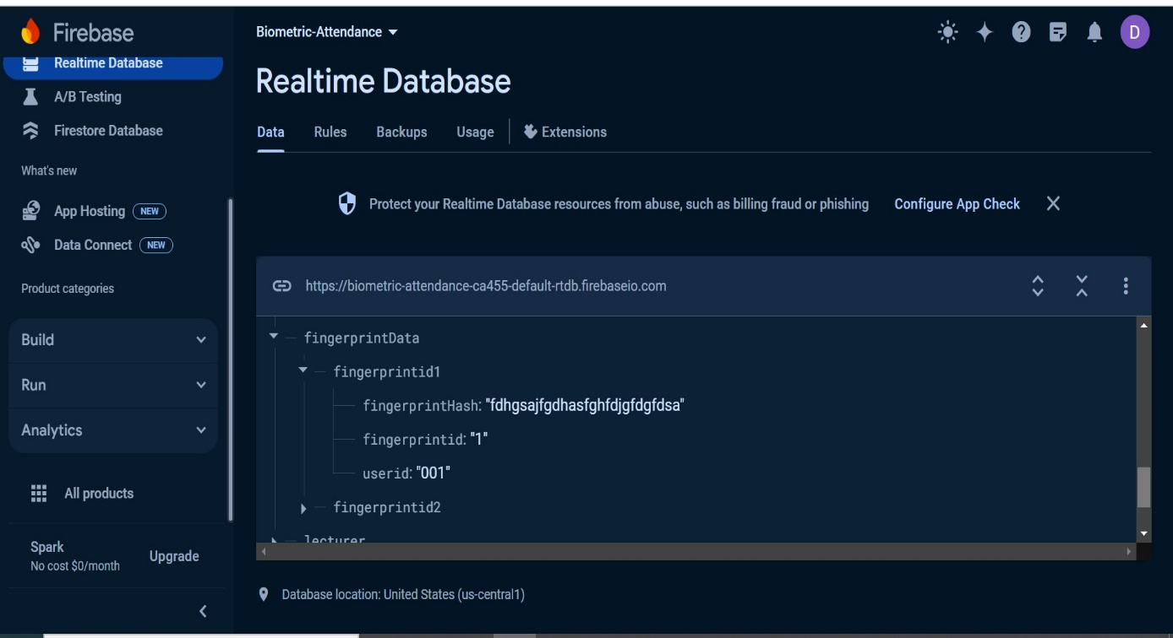
8. FingerprintData Collection

Slide 20
Our presentation provides a comprehensive database design for an attendance management system. By following a systematic design process, including requirement analysis, conceptual design, logical design, and normalization. The resulting database schema ensures efficient, secure, and organized management of student attendance.
Also the detailed relational schema and ER diagram provide a clear roadmap for implementing the database. This design forms a robust foundation for developing a functional and reliable attendance management system.
06: CONCLUSION

